Slide 1
oTree
Filipp Chapkovski
April 3-4, 2017

Slide 2
Link to go now: | http://bit.ly/otree-mainz
Materials and code for this workshop: | https://github.com/chapkovski/mainz
My e-mail: | chapkovski@gmail.com
oTree support group: | https://groups.google.com/forum/#!forum/otree

Slide 3
Outline
April 3, Monday
Session 1 – main oTree components (views, models, templates)
Session 2 – multi player, multi-round games in oTree
April 4, Tuesday
Session 3 – multi player, multi-round games in oTree
Session 4 – Advanced oTree: channels, mTurk. Discussion of participants’ projects

Slide 4
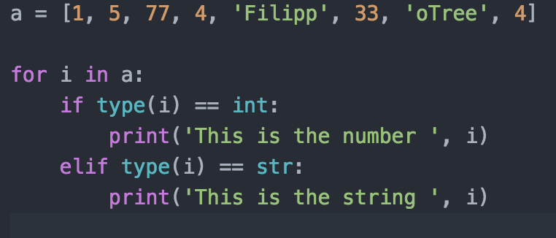
Python in 5 minutes
Indent to begin the block
Comment: #
Lists: a = [1, 2, 3,]

Slide 5
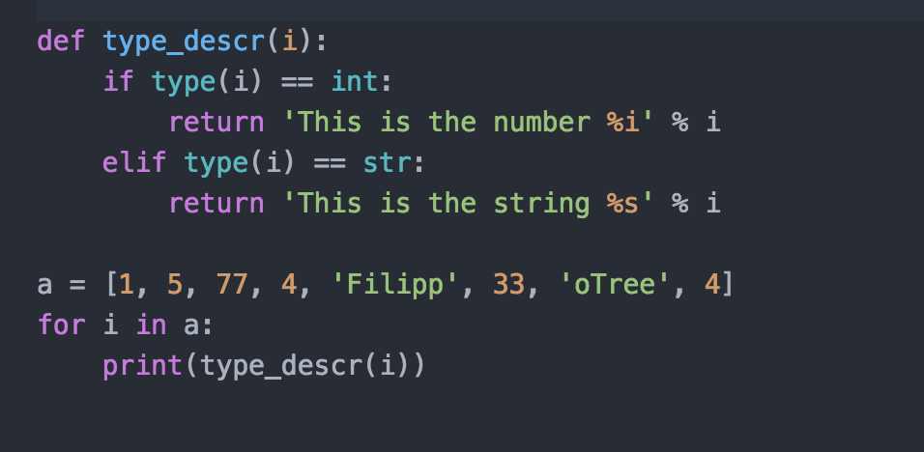
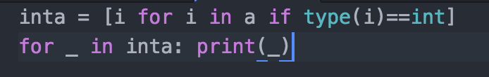
Python in 5 minutes
Function declaration:
List comprehension:

Slide 6
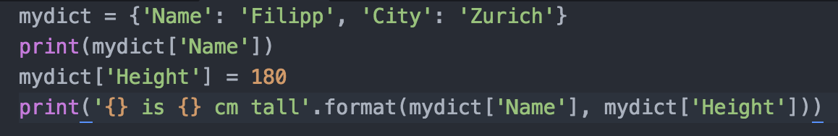
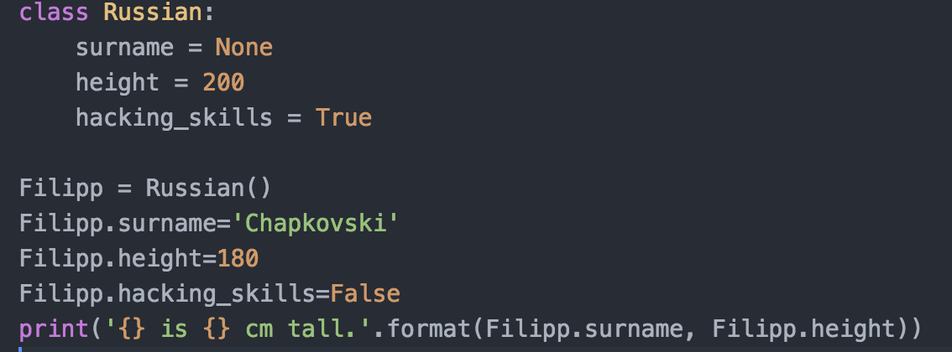
Python in 5 minutes
Dictionary:
Class:

Slide 7
MVC

Slide 8
Creating first project and first app
virtualenv mainzwp
cd mainzwp
otree startproject mainz
otree startapp guessquiz
settings.py:
SESSION_CONFIGS = [
{
'name': 'guess',
'display_name': 'Guess game',
'num_demo_participants': 1,
'app_sequence': ['guess'],
},

Slide 9
oTree: general structure of an App
VIEWS: views.py
MODELS: models.py
TEMPLATES: templates/APP_NAME/templates
static files (images etc.): static/APP_NAME/static
bots: tests.py

Slide 10
General structure: models.py
import *
constants
three tables:
Subsession
Group
Player

Slide 11
General structure: views.py
import *
Page declarations
page_sequence

Slide 12
Guess game: planning
A player has an endowment.
Random number is generated within certain limits
A player has to guess. The closer is the guyess to a real number the larger is the profit.
Two fields: what is guessed, and a player’s decision
Three screens:
Intro: instructions
Decision with instructions
Results

Slide 13
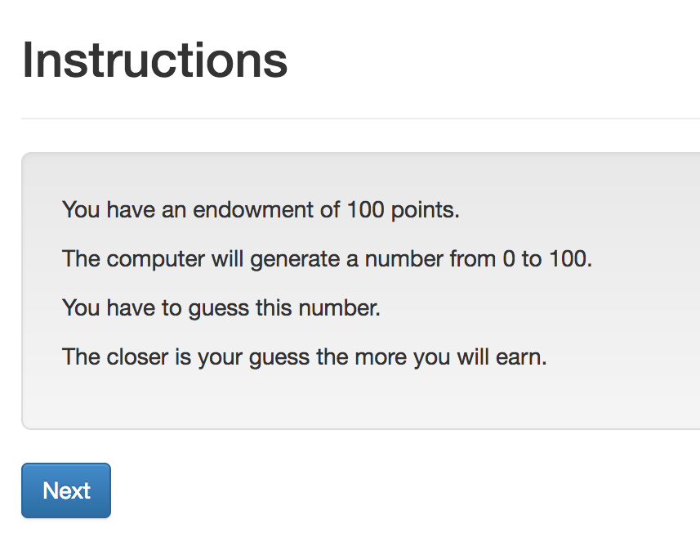
Guess game: screen 1

Slide 14
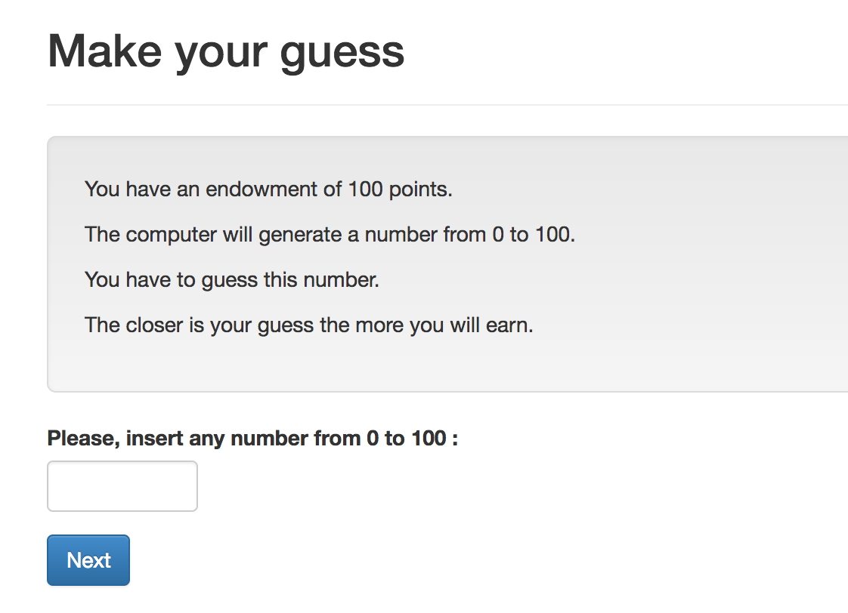
Guess game: screen 2

Slide 15
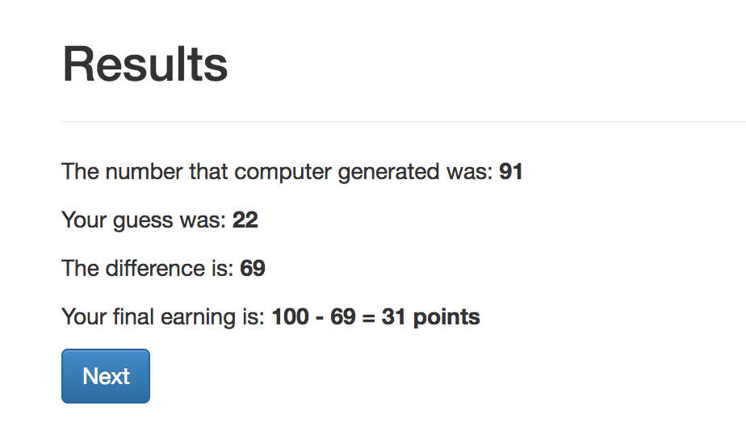
Guess game: screen 3

Slide 16
Guess game - Models
Creating new fields:
Field_Name = models.IntegerField()
Options:
Field_Name = models.IntegerField(
max=…,
min=…,
verbose_name=…,)

Slide 17
Guess game: Models. Result:
class Player(BasePlayer):
toguess = models.IntegerField(min=Constants.minguess,
max=Constants.maxguess,
doc='random number for a player to guess')
guess = models.IntegerField(min=Constants.minguess,
max=Constants.maxguess,
verbose_name="Please, insert \
any number from {} to \
{}".format(Constants.minguess,
Constants.maxguess,),
doc='guess of the player')

Slide 18
Guess game: Views
Creating new page
Class NameOfThePage(Page):
pass
Page_sequence
Page_sequence = [NameOfThePage]
By default name of the template should correspond to the page name!

Slide 19
Guess game: Views. Built-in functions
Built-in functions of pages:
”Normal” page:
def is_displayed(self):
return (True/False)
def vars_for_template(self):
return {‘var’: var}
def before_next_page(self):
…

Slide 20
Guess game - Templates
{% extends "global/Page.html" %}
{% load staticfiles otree_tags %}
{% block title %} YOUR TITLE HERE {% endblock %}
{% block content %}
YOUR CONTENT HERE
{% endblock %}

Slide 21
Guess game - Templates
to include another file (for example instructions):
{% include ‘path_to_file/name_of_file.html %}
to make ‘Next button’:
{% next_button %}

Slide 22
Guess game: Views. Intro

Slide 23
Intro: How to do it?
Models.py: Constants:
endowment
minguess
maxguess
Intro.html:
in {% block content %}:
to refer to the constant: {{Constants.endowment}}.
Case sensitive!
No calculations! It is not Python!

Slide 24
Intro: Results:
{% extends "global/Page.html" %}
{% load staticfiles otree_tags %}
{% block title %}Instructions{% endblock %}
{% block content %}
{% include 'guess/instructions.html' %}
{% next_button %}
{% endblock %}
WHY?

Slide 25
Views.Decision

Slide 26
Views.Decision. How to do it?
Referring to models. field in views.py:
class Decision(Page):
form_model = models.Player
form_fields = ['guess']
referring to a field in a template:
{% formfield player.guess %} OR {{form}}
Generating random number:
class Intro(Page):
def before_next_page(self):
toguess = random.randint(Constants.minguess, Constants.maxguess)
self.player.toguess = toguess

Slide 27
Views.Resuts

Slide 28
Views.Resuts. How to do it?
in views.py: Decision page:
class Decision(Page):
...
def before_next_page(self):
self.player.set_payoff()
in models.py :
class Player(BasePlayer):
…
def set_payoff(self):
self.diff = abs(self.guess - self.toguess)
self.payoff = Constants.endowment - self.diff

Slide 29
Running the app
otree resetdb
otree runserver
go to: http://127.0.0.1:8000

Slide 30
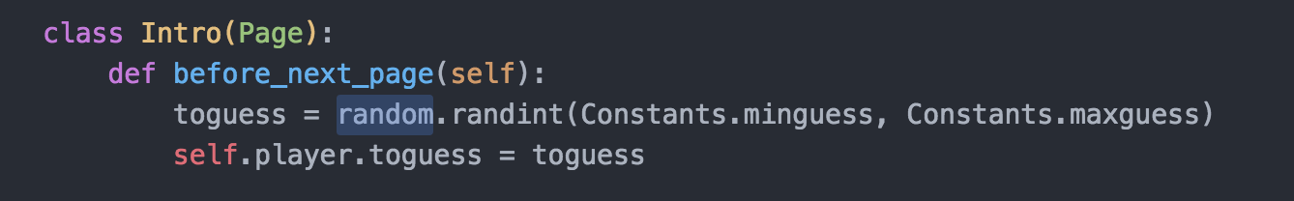
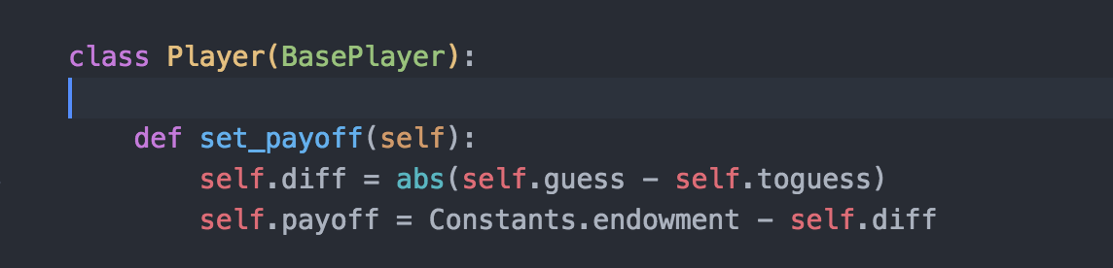
what is self?
SELF refers to the object of the class where we currently work in.

Slide 31
Hierarchy of objects
Session
Subsession
Group
Player - Participant
Page
TABLES

Slide 32
What runs when
Class definition:
class Player(BasePlayer)
class MyPage(Page)
Subsession: def before_session starts(self)
Page: is_displayed(self)
Page: vars_for_template(self)
Page: before_next_page(self)
WaitPage: is_displayed(self)
WaitPage: after_all_players_arrive(self)

Slide 33
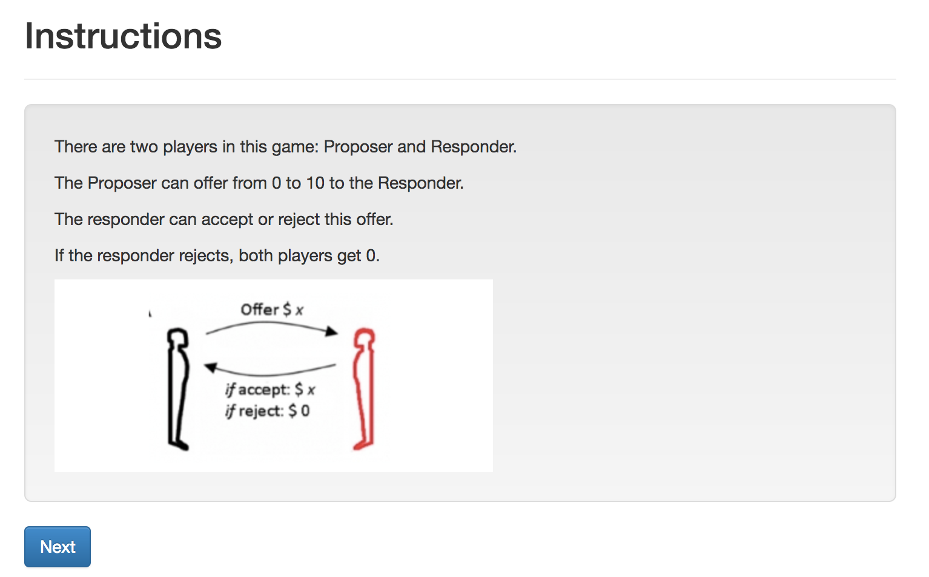
Ultimatum. Screen 1. Intro

Slide 34
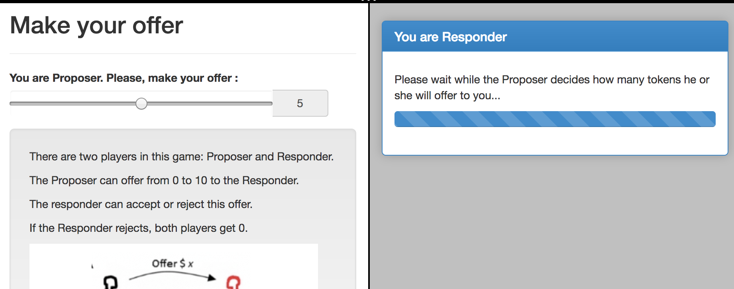
Ultimatum. Screen 2. Offer

Slide 35
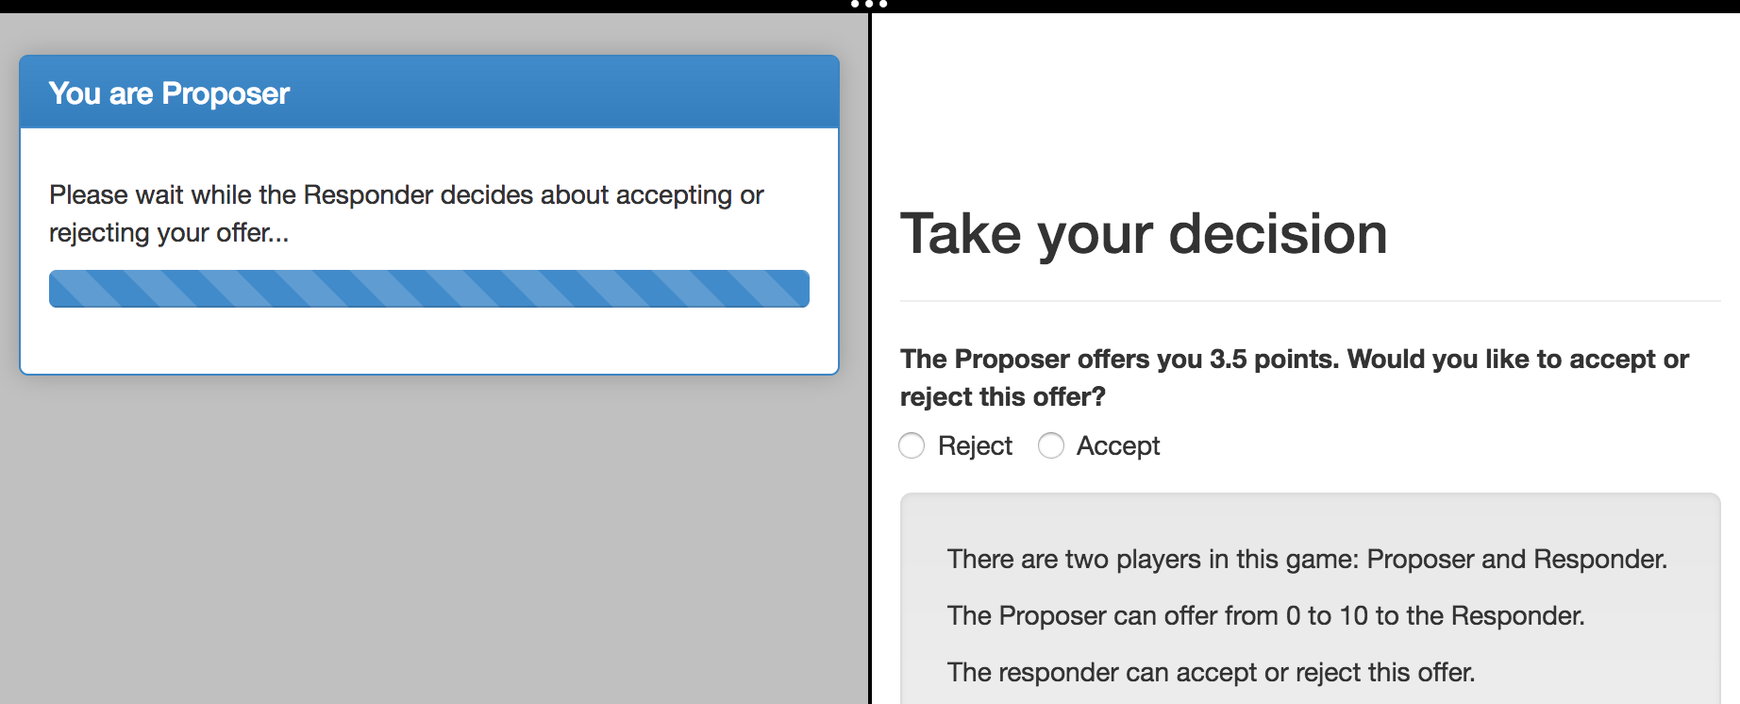
Ultimatum. Screen 3. Accept/Reject

Slide 36
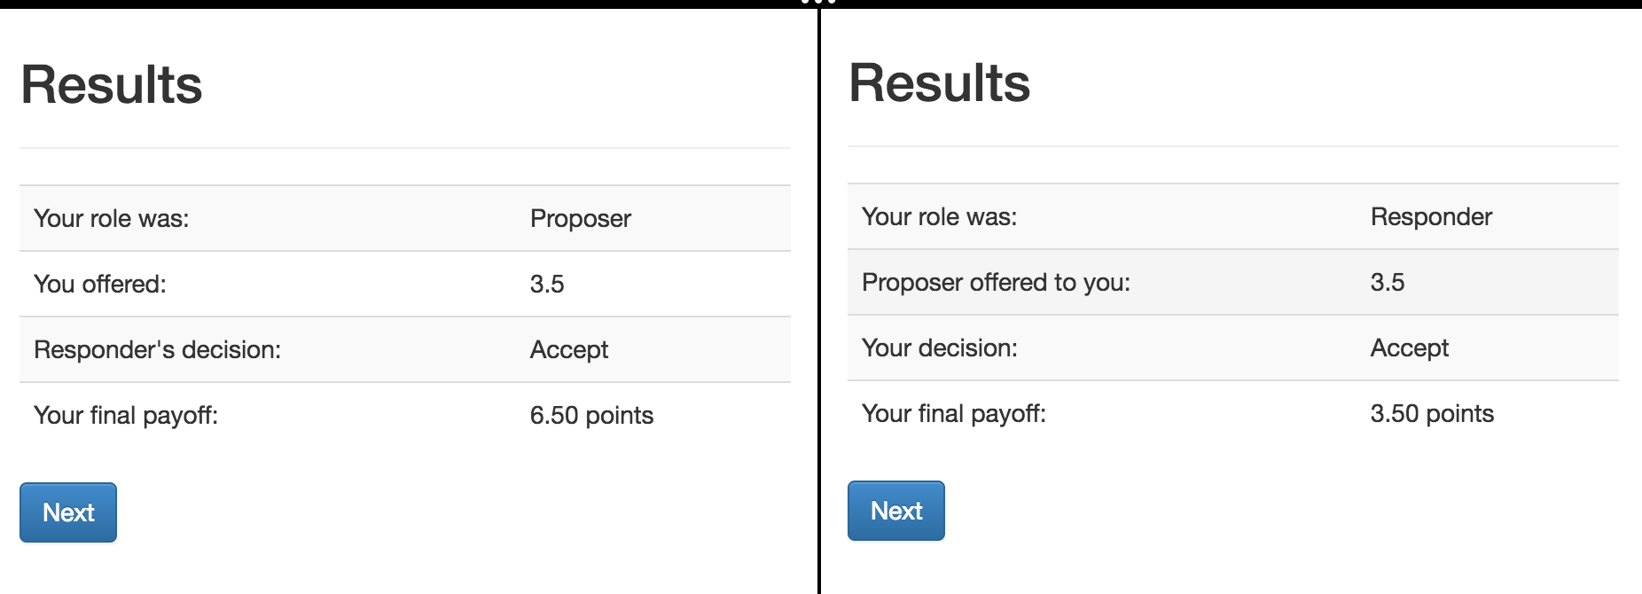
Ultimatum. Screen 4. Results

Slide 37
Ultimatum: some preliminary prep
Let’s run ‘otree startapp ultimatum’
and copy from our guess app: intro, decision, instructions
… rename in intro and decision the % include %:
TO: {% include 'ultimatum/instructions.html' %}
make a copy of decision.html
rename files to: Offer.html, Accept.html

Slide 38
Ultimatum: multi-player game
In models.py: Constants: players_per_group = 2
NB: when there is only one player then players_per_group = None, not 1!
In Player we define function that returns the role
class Player(BasePlayer):
def role(self):
if self.id_in_group == 1:
return 'Proposer'
if self.id_in_group == 2:
return 'Responder'

Slide 39
Ultimatum: planning I
The workflow:
1. Introduction
2. Player 1 decides about an offer, Player 2 waits
3. Player 2 decides whether accepting or not. Player 1 waits.
4. Both see the results.
We need 6 pages. For (2) and (3) we a set of (Page, WaitPage)
Page in (2) will be shown only to Proposer
Page in (3) will be shown only to Responder

Slide 40
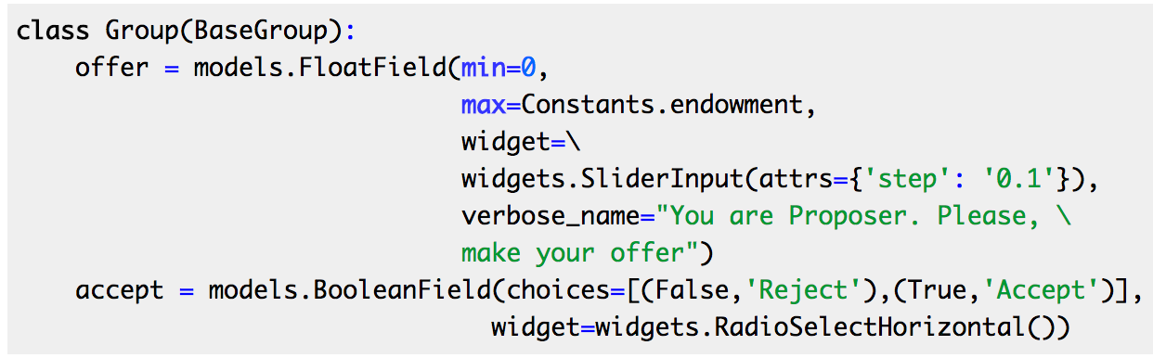
Ultimatum: models.py
Creating new fields in models.py:
We need fields in group, because these fields are the same for both players.
Notes:
class Group(BaseGroup):
offer = models.FloatField(min=0,
max=Constants.endowment,
widget=\
widgets.SliderInput(attrs={'step': '0.1'}),
verbose_name="You are Proposer. Please, \
make your offer")
accept = models.BooleanField(choices=[(False,'Reject'),(True,'Accept')],
widget=widgets.RadioSelectHorizontal())
def set_payoffs(self):
proposer = self.get_player_by_role('Proposer')
responder = self.get_player_by_role('Responder')
proposer.payoff = (Constants.endowment - self.offer) * self.accept
responder.payoff = self.offer * self.accept

Slide 41
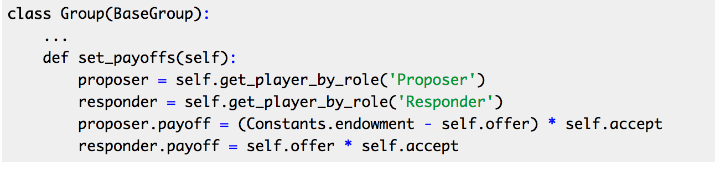
Ultimatum: models.py
Defining the function that will be able to set the payoffs of the players depending on their role in a group:
Notes:
class Group(BaseGroup):
offer = models.FloatField(min=0,
max=Constants.endowment,
widget=\
widgets.SliderInput(attrs={'step': '0.1'}),
verbose_name="You are Proposer. Please, \
make your offer")
accept = models.BooleanField(choices=[(False,'Reject'),(True,'Accept')],
widget=widgets.RadioSelectHorizontal())
def set_payoffs(self):
proposer = self.get_player_by_role('Proposer')
responder = self.get_player_by_role('Responder')
proposer.payoff = (Constants.endowment - self.offer) * self.accept
responder.payoff = self.offer * self.accept

Slide 42
Static files: how insert an image?
Create folder in an app:
…/static/ultimatum
Put your image there
insert in in the beginning of your instructions.html:
{% load staticfiles %}
and in the text:
<img src="{% static "ultimatum/ultimatum.png" %}"/>
Notes:
from otree.api import Currency as c, currency_range
from . import models
from ._builtin import Page, WaitPage
from .models import Constants
class Intro(Page):
pass
class Offer(Page):
form_model = models.Group
form_fields = ['offer']
def is_displayed(self):
return self.player.role() == 'Proposer'
def vars_for_template(self):
...
class OfferWaitPage(WaitPage):
title_text = "You are Responder"
body_text = "Please wait while the Proposer decides how many tokens he \
or she will offer to you..."
class Accept(Page):
form_model = models.Group
form_fields = ['accept']
def is_displayed(self):
return self.player.role() == 'Responder'
def vars_for_template(self):
return {'offer_text': "The Proposer offers you {} points. Would you like \
to accept or reject this offer?".format(self.group.offer)}
class ResultsWaitPage(WaitPage):
title_text = "You are Proposer"
body_text = "Please wait while the Responder decides about accepting \
or rejecting your offer..."
def after_all_players_arrive(self):
self.group.set_payoffs()
class Results(Page):
def vars_for_template(self):
return {'accept': 'Accept' if self.group.accept else 'Reject'}
page_sequence = [
Intro,
Offer,
OfferWaitPage,
Accept,
ResultsWaitPage,
Results
]

Slide 43
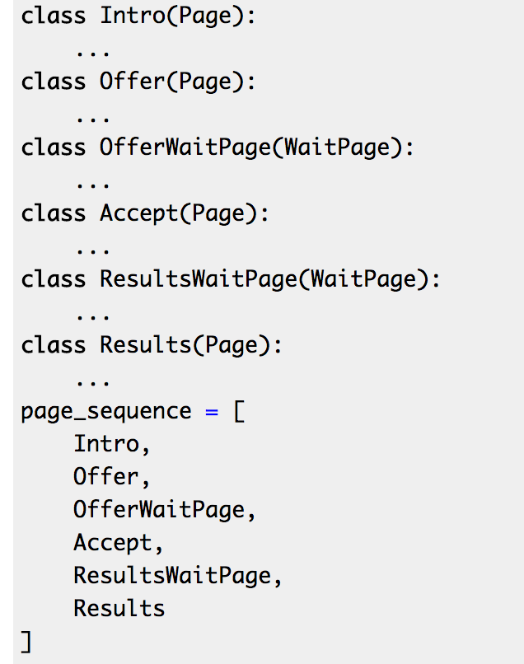
Ultimatum: views.py
class Offer(Page):
form_model = models.Group
form_fields = ['offer']
def is_displayed(self):
return self.player.role() == 'Proposer'
class OfferWaitPage(WaitPage):
title_text = "You are Responder"
body_text = "Please wait while the Proposer decides how many tokens he \
or she will offer to you...”
def is_displayed(self):
return self.player.role() == 'Responder'
Notes:
from otree.api import Currency as c, currency_range
from . import models
from ._builtin import Page, WaitPage
from .models import Constants
class Intro(Page):
pass
class Offer(Page):
form_model = models.Group
form_fields = ['offer']
def is_displayed(self):
return self.player.role() == 'Proposer'
def vars_for_template(self):
...
class OfferWaitPage(WaitPage):
title_text = "You are Responder"
body_text = "Please wait while the Proposer decides how many tokens he \
or she will offer to you..."
class Accept(Page):
form_model = models.Group
form_fields = ['accept']
def is_displayed(self):
return self.player.role() == 'Responder'
def vars_for_template(self):
return {'offer_text': "The Proposer offers you {} points. Would you like \
to accept or reject this offer?".format(self.group.offer)}
class ResultsWaitPage(WaitPage):
title_text = "You are Proposer"
body_text = "Please wait while the Responder decides about accepting \
or rejecting your offer..."
def after_all_players_arrive(self):
self.group.set_payoffs()
class Results(Page):
def vars_for_template(self):
return {'accept': 'Accept' if self.group.accept else 'Reject'}
page_sequence = [
Intro,
Offer,
OfferWaitPage,
Accept,
ResultsWaitPage,
Results
]

Slide 44
Ultimatum: views.py
class Accept(Page):
form_model = models.Group
form_fields = ['accept']
def is_displayed(self):
return self.player.role() == 'Responder'
def vars_for_template(self):
return {'offer_text': "The Proposer offers you {} points. Would you like \
to accept or reject this offer?".format(self.group.offer)}
class ResultsWaitPage(WaitPage):
title_text = "You are Proposer"
body_text = "Please wait while the Responder decides about accepting \
or rejecting your offer..."
def after_all_players_arrive(self):
self.group.set_payoffs()
Notes:
from otree.api import Currency as c, currency_range
from . import models
from ._builtin import Page, WaitPage
from .models import Constants
class Intro(Page):
pass
class Offer(Page):
form_model = models.Group
form_fields = ['offer']
def is_displayed(self):
return self.player.role() == 'Proposer'
def vars_for_template(self):
...
class OfferWaitPage(WaitPage):
title_text = "You are Responder"
body_text = "Please wait while the Proposer decides how many tokens he \
or she will offer to you..."
class Accept(Page):
form_model = models.Group
form_fields = ['accept']
def is_displayed(self):
return self.player.role() == 'Responder'
def vars_for_template(self):
return {'offer_text': "The Proposer offers you {} points. Would you like \
to accept or reject this offer?".format(self.group.offer)}
class ResultsWaitPage(WaitPage):
title_text = "You are Proposer"
body_text = "Please wait while the Responder decides about accepting \
or rejecting your offer..."
def after_all_players_arrive(self):
self.group.set_payoffs()
class Results(Page):
def vars_for_template(self):
return {'accept': 'Accept' if self.group.accept else 'Reject'}
page_sequence = [
Intro,
Offer,
OfferWaitPage,
Accept,
ResultsWaitPage,
Results
]

Slide 45
Ultimatum: dynamic label in Accept
{% block content %}
{% formfield group.accept with label=offer_text %}
{% include 'ultimatum/instructions.html' %}
<br>
{% next_button %}
{% endblock %}

Slide 46
Ultimatum. Results
<table class="table table-striped table-hover">
<tr>
<td>Your role was:</td>
<td>{{player.role}}</td>
</tr>
{% if player.role == "Proposer" %}
<tr>
<td>You offered:</td>
<td>{{group.offer}}</td>
</tr>
<tr>
<td>Responder's decision:</td>
<td>{{accept}}</td>
</tr>
{% else %}
<tr>
<td>Proposer offered to you:</td>
<td>{{group.offer}}</td>
</tr>
<tr>
<td>Your decision:</td>
<td>{{accept}}</td>
</tr>
{% endif %}
<tr>
<td>Your final payoff:</td>
<td>{{player.payoff}}</td>
</tr>
</table>
Notes:
{% extends "global/Page.html" %}
{% load staticfiles otree_tags %}
{% block title %}
Results
{% endblock %}
{% block content %}
<table class="table table-striped table-hover">
<tr>
<td>Your role was:</td>
<td>{{player.role}}</td>
</tr>
{% if player.role == "Proposer" %}
<tr>
<td>You offered:</td>
<td>{{group.offer}}</td>
</tr>
<tr>
<td>Responder's decision:</td>
<td>{{accept}}</td>
</tr>
{% else %}
<tr>
<td>Proposer offered to you:</td>
<td>{{group.offer}}</td>
</tr>
<tr>
<td>Your decision:</td>
<td>{{accept}}</td>
</tr>
{% endif %}
<tr>
<td>Your final payoff:</td>
<td>{{player.payoff}}</td>
</tr>
</table>
{% next_button %}
{% endblock %}

Slide 47
Ultimatum. Results
<table class="table table-striped table-hover">
<tr>
<td>Your role was:</td>
<td>{{player.role}}</td>
</tr>
{% if player.role == "Proposer" %}
<tr>
<td>You offered:</td>
<td>{{group.offer}}</td>
</tr>
<tr>
<td>Responder's decision:</td>
<td>{{accept}}</td>
</tr>
{% else %}
<tr>
<td>Proposer offered to you:</td>
<td>{{group.offer}}</td>
</tr>
<tr>
<td>Your decision:</td>
<td>{{accept}}</td>
</tr>
{% endif %}
<tr>
<td>Your final payoff:</td>
<td>{{player.payoff}}</td>
</tr>
</table>
class Results(Page):
def vars_for_template(self):
return {'accept': 'Accept' if self.group.accept else 'Reject'}
in settings.py:
POINTS_DECIMAL_PLACES = 2
Notes:
{% extends "global/Page.html" %}
{% load staticfiles otree_tags %}
{% block title %}
Results
{% endblock %}
{% block content %}
<table class="table table-striped table-hover">
<tr>
<td>Your role was:</td>
<td>{{player.role}}</td>
</tr>
{% if player.role == "Proposer" %}
<tr>
<td>You offered:</td>
<td>{{group.offer}}</td>
</tr>
<tr>
<td>Responder's decision:</td>
<td>{{accept}}</td>
</tr>
{% else %}
<tr>
<td>Proposer offered to you:</td>
<td>{{group.offer}}</td>
</tr>
<tr>
<td>Your decision:</td>
<td>{{accept}}</td>
</tr>
{% endif %}
<tr>
<td>Your final payoff:</td>
<td>{{player.payoff}}</td>
</tr>
</table>
{% next_button %}
{% endblock %}

Slide 48
Github and Heroku
Install Heroku toolbelt
git config --global user.name "John Doe”
git config --global user.email johndoe@example.com
git config --global credential.helper wincred
git credential-osxkeychain

